Slide 1
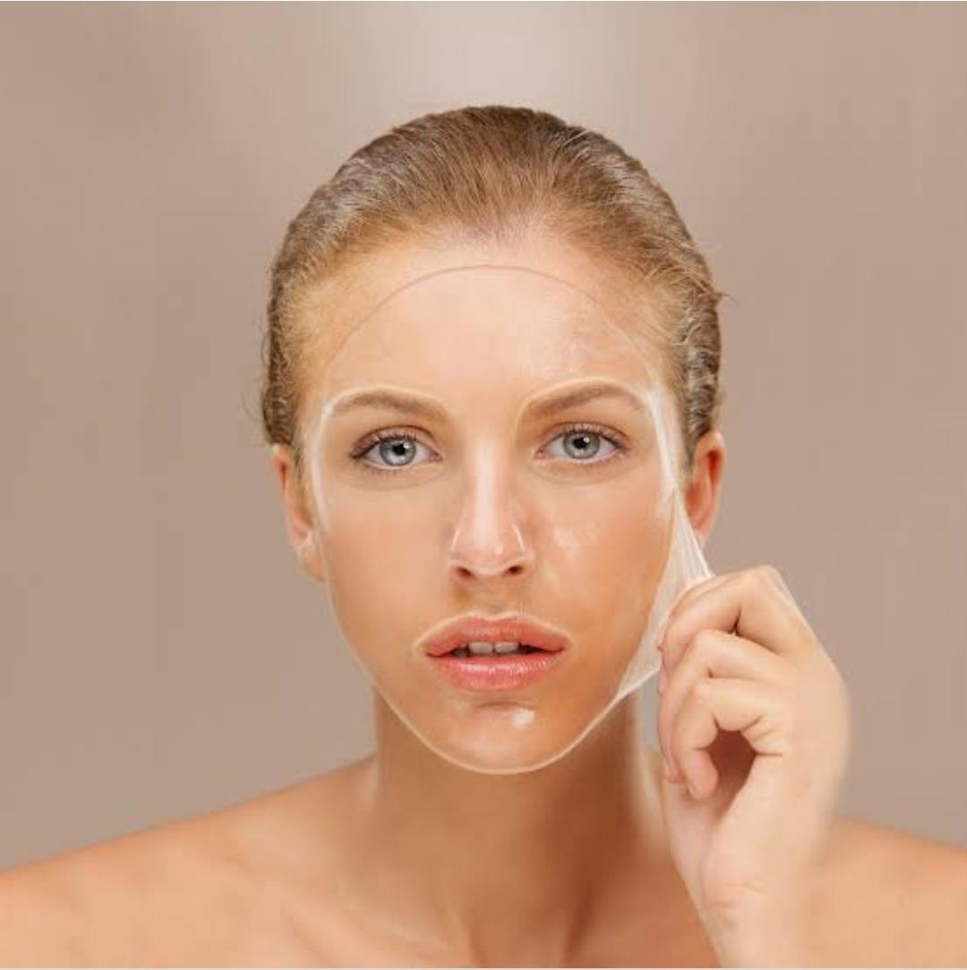
GEL YOUR FACE
SUBHASHITHA S (202BT189)
KATHIRVELAN V (202BT135)
DEPARTMENT OF BIOTECHNOLOGY
BANNARI AMMAN INSTITUTE OF TECHNOLOGY

Slide 2
Abstract
peel off transparent face mark helps to hydrate the skin, which is Jelly- type mask. Due to its transparent property, they are -water-soluble. Its aqueous solution is stable and as transparent as water. In this mask, the hydrophilic solvents are carefully blended to obtain progressive evaporation but also an immediate moisturizing effect. A water-soluble crystalline polymer that has excellent film forming, emulsifying and adhesive property. The polymeric compound in association with solvents also ensure good potential for dissolution and the absorption of all sebaceous materials from the skin surface. This type of mask is claimed to accelerate blood circulation and slow aging.

Slide 3
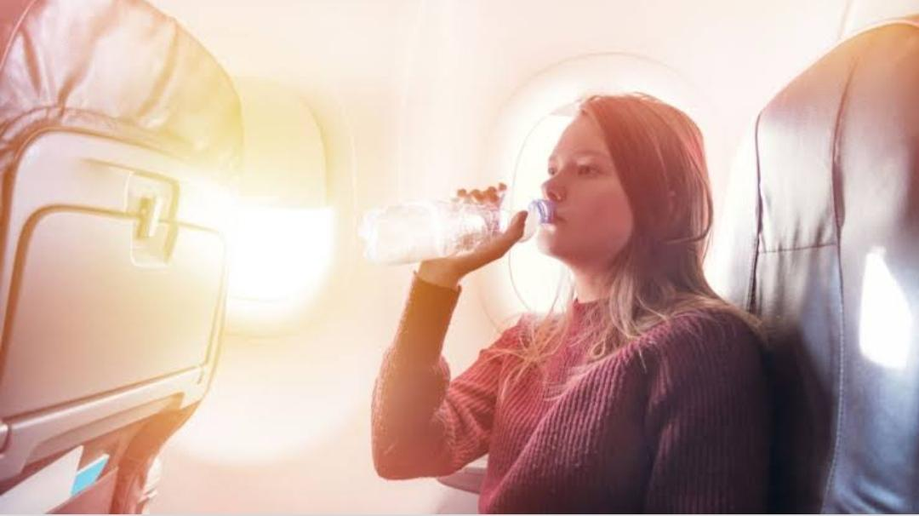
Problem Statement Addressed
Travelling dehydrates the skin. Skin can feel dry and dehydrated by the time the journey is over. The dry air during travel can irritate your skin, for those who with dry skin, the air can exacerbate the dryness, while those who have oily skin could produce excess oils to compensate for the dryness.

Slide 4
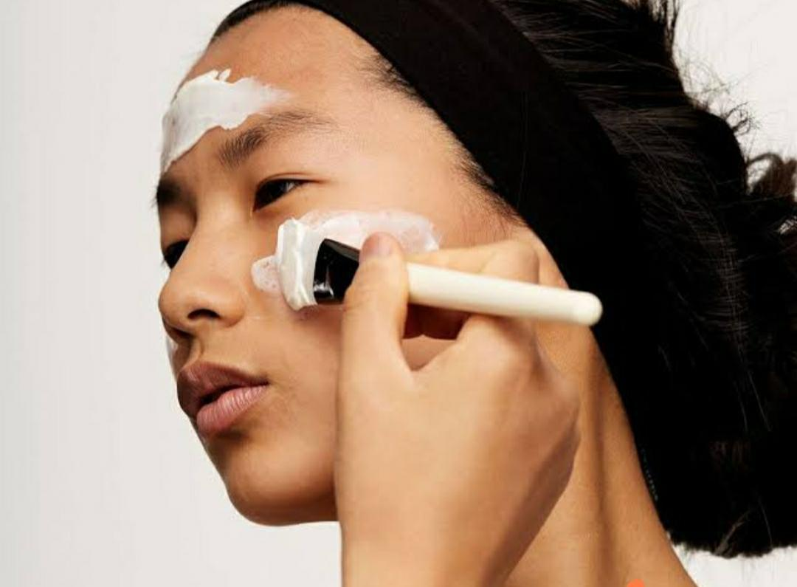
Existing Solution to the Problem Addressed
Using peel off transparent face mask traps the moisture in the skin and creates film that helps to hydrate and moisturize the skin

Slide 5
Prototype & Sample Output

Slide 6
Analysis of Results & Discussions
(Included clear analysis, along with advantages and disadvantages,
Conclusions)

Slide 7
Cost Benefit Analysis (List of Components / Service Used)
(Budget)
S.No | Component Name | Specification (IC number or Range or Value) | Unit Cost | Total Cost

Slide 8
References
Ariponnammal, S. and Natarajan, S. (1994) “Transport Phonomena of SmSel – Xasx”, Pramana – Journal of Physics Vol.42, No.1, pp.421-425.
Barnard, R.W. and Kellogg, C. (1980), “Applications of Convolution Operators to Problems in Univalent Function Theory”, Michigan Mach, J., Vol.27, pp.81-94.
Shin, K.G. and Mckay, N.D. (1984), “Open Loop Minimum Time Control of Mechanical Manipulations and its Applications‟, Proc. Amer. Contr. Conf., San Diego, CA, pp. 1231-1236.
(sample references, the same format should be followed throughout)

